Slide 1
StellarSnap
Visual discovery engine for finding ideas, people, trends, home, style inspiration, and more
PixelTriads/Team number: 3
Pearl (Team Leader) 2210990648
Prachi Anand 2210990660
Prachi Malik 2210990661

Slide 2
Index
Objective
Introduction
Methodology, Approach & Techniques
Algorithm
Flow Chart
Result
Source Code (Screenshots)
Conclusion
Reference

Slide 3
Objective
The objective of StellarSnap, the website created using HTML, CSS, and JavaScript, could be multi-faceted, aiming to accomplish several goals:
Provide Visual Bookmarking Service: StellarSnap should allow users to visually bookmark content from around the web.
User Engagement: Encourage users to engage actively with the platform by saving, sharing, and commenting on pins. Increasing user interaction contributes to the growth and sustainability of the platform.
Personalization and Curation: Enable users to personalize their experience by curating boards and following other users with similar interests.

Slide 4
Introduction
StellarSnap is a visual discovery engine for finding ideas like recipes, home and style inspiration, and more. With billions of Pins on StellarSnap, you'll always find ideas to spark inspiration. When you discover Pins you love, save them to boards to keep your ideas organized and easy to find. You can also create Pins to share your ideas with other people on StellarSnap.
Your home feed is where you'll find Pins, people and businesses we think you'll love, based on your recent activity. We'll also show you Pins from the people and boards you choose to follow.
You can also search for Pins by typing in keywords into the search bar. Try typing "birthday party" in the search bar to see ideas for birthday party decor, party food recipes, and birthday gift ideas.

Slide 5
6. Deployment and Launch: Deploy the platform to production and execute a marketing strategy.
7. User Feedback and Iteration: Gather user feedback and iterate based on usage metrics and behavior.
8. Maintenance and Support: Provide ongoing maintenance and updates to keep the platform stable and secure.

Slide 6
Techniques:
Various techniques used to build StellarSnap are:
1. HTML, or Hypertext Markup Language, is the standard markup language used to create and structure content on web pages. 2. CSS, or Cascading Style Sheets, is a style sheet language used to describe the presentation and visual formatting of HTML and XML documents.
3. JavaScript is a high-level, interpreted programming language primarily used for building dynamic and interactive web applications.
4. React.js is a powerful library for building dynamic and responsive user interfaces.
5. Local storage is a web storage API that allows developers to store data locally within the user's browser.

Slide 7
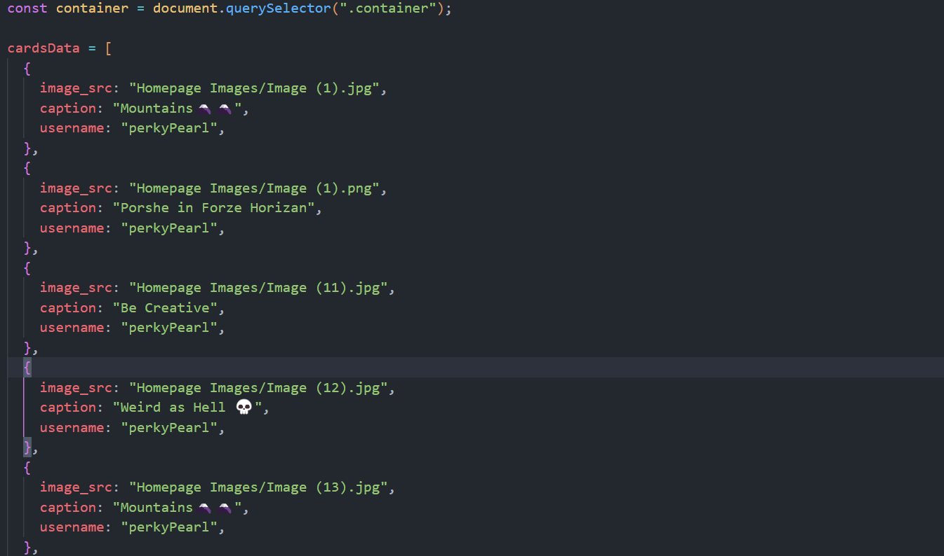
Algorithm
Data Compilation: Gather the Information and Store that into the form of arrays of JSON(JavaScript Object Notation) with the Source of the Images, Caption and Username of the Person who posted it.
Fig (1). Snapshot Of Data Compilation

Slide 8
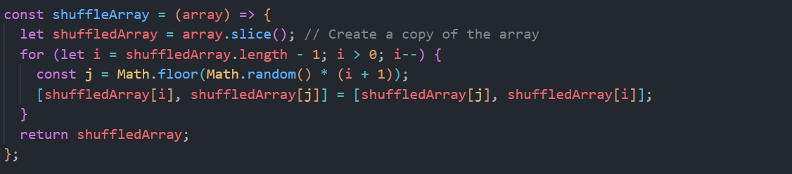
Algorithm
Randomizer: It Creates an array of the size of the data to be displayed on the Feed. It creates a random unique elements array and stores that into an array
Fig (2). Snapshot Of Randomizer

Slide 9

Algorithm
Generating Cards: This creates the Cards on the Webpage using DOM (Document Object Model) Manipulation. It access the Data from the Database in this case, Array of JSON and access their Images Sources, Caption and User who sent that. And Renders it.
Fig (3). Snapshot Of Generating Cards

Slide 10
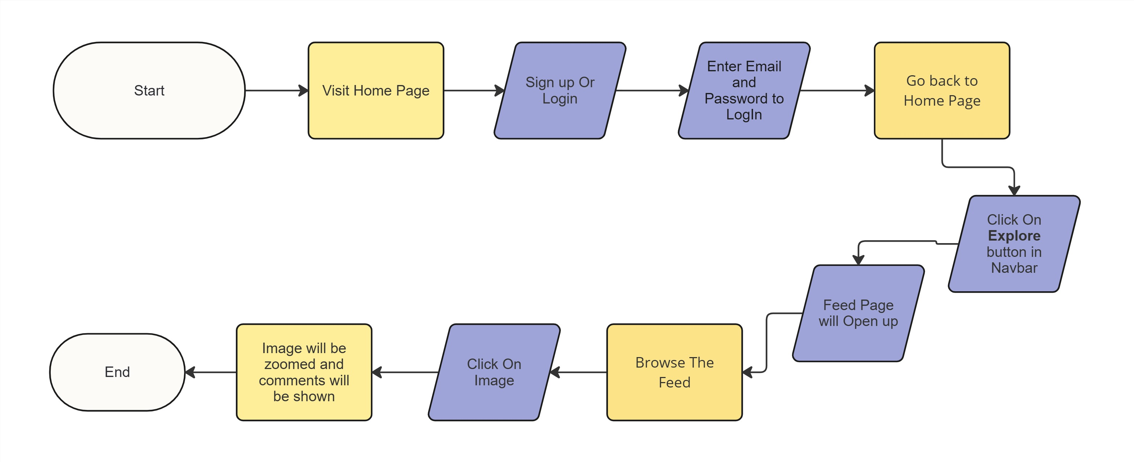
Flowchart

Slide 11
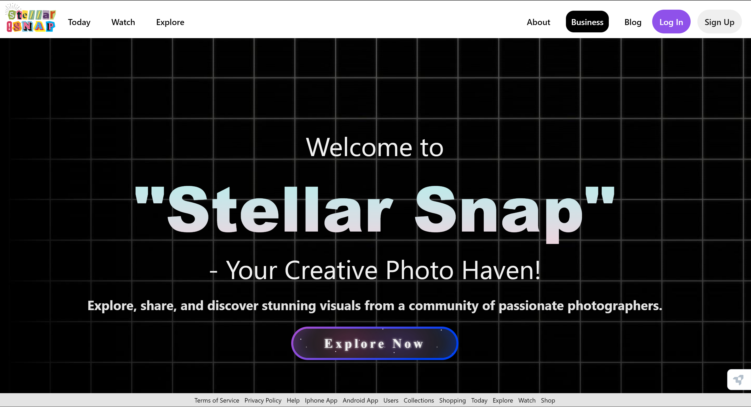
Result
Fig (4). Screenshot Of Home Page

Slide 12
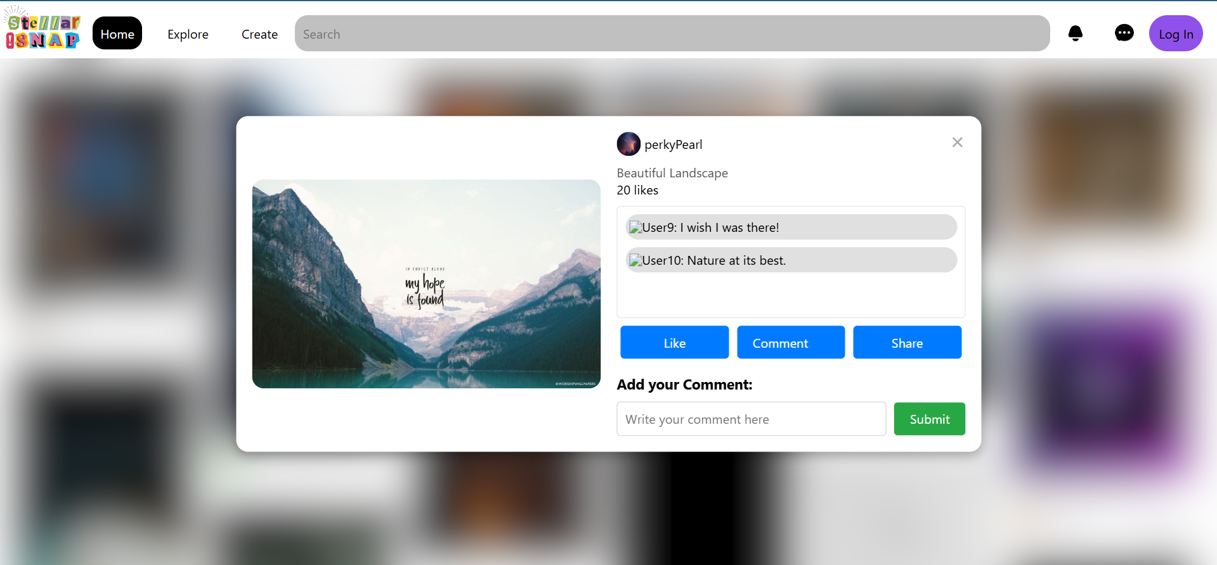
Feed while sharing post with someone
Fig (5). Screenshot Of Feed when you share a post with someone

Slide 13
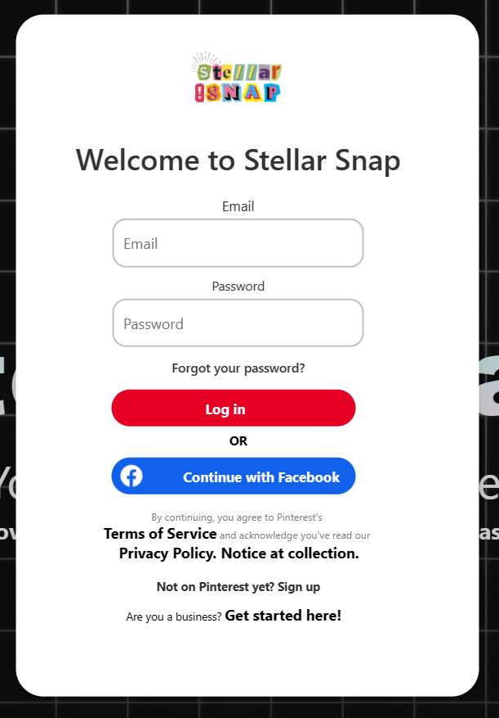
Result
Fig (6). Screenshot Of Login Overlay

Slide 14

Result
Fig (7). Screenshot Of Navbar

Slide 15
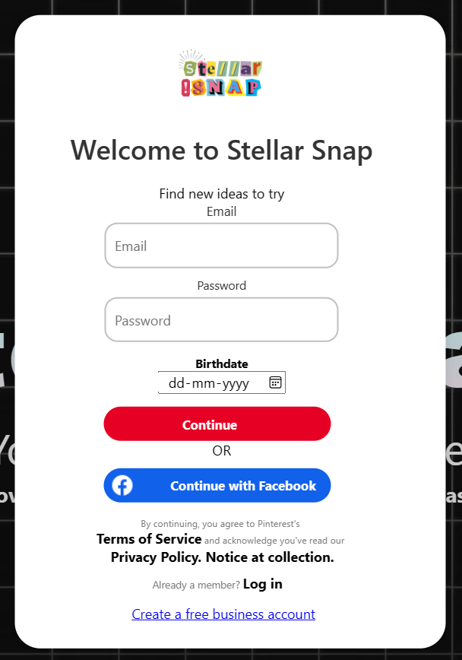
Result
Fig (8). Screenshot Of Sign Up Overlay

Slide 16
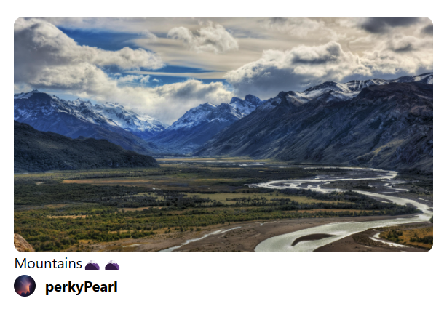
Result
Fig (9). Screenshot Of Card Component

Slide 17
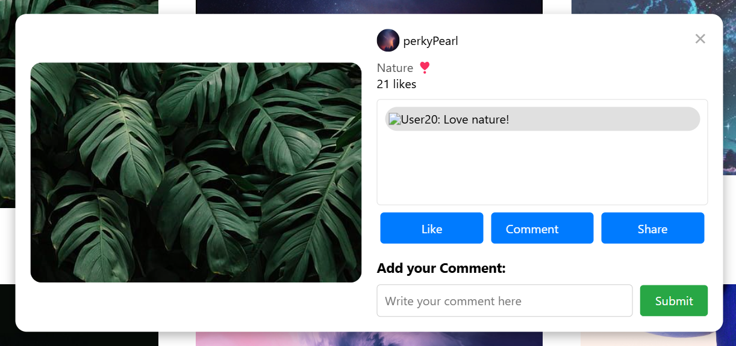
Result
Fig (10). Screenshot Of Window Component

Slide 18
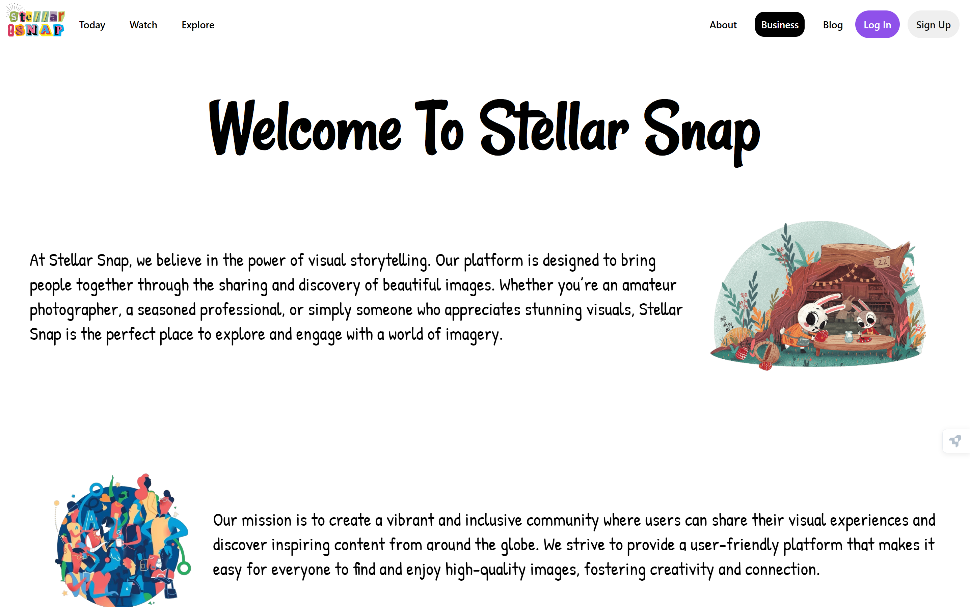
Result
Fig (11). Screenshot Of About Us Component

Slide 19
Conclusion
In conclusion, StellarSnap presents itself as a promising contender in the realm of social media platforms, offering users a visually appealing and intuitive interface akin to Pinterest. Through its innovative features, seamless user experience, and robust community engagement tools, StellarSnap has the potential to carve out its own niche in the market. As we've explored throughout this analysis, its emphasis on creativity, inspiration, and seamless content discovery sets it apart, catering to a diverse range of interests and passions. Moving forward, continued focus on user feedback, technological advancements, and strategic partnerships will be pivotal in sustaining StellarSnap's growth trajectory and solidifying its position as a leading destination for visual discovery and inspiration on the web.

Slide 20
Reference
Pinterest, https://in.pinterest.com/,Accessed on March 3, 2024
ChatGPT, chat.openai.com, Accesed on March 1,2024
Google, https://www.google.com, Accesed on February 25,2024

